Slide 1
Predicting Stock Market Trends Using Machine Learning and Deep Learning Algorithms Via Continuous and Binary Data a Comparative Analysis
Department of CSE
Batch No: 18
Team Members:
217R1A0563 - V. Madhurima
217R1A0538 - N. Kalyan Reddy
217R1A0502 - A. Adarsh Reddy
Under the guidance of
Mrs Rakshitha
(Assistant Professor)

Slide 2
Table of contents
Abstract
Existing Systems
Disadvantages
Proposed System
Advantages
Hardware and Software Requirements
System Architecture
Sequence Diagram​
Use Case Diagram
Class Diagram
Collabo
Queries
​

Slide 3
Abstract
The study aims to reduce the risks associated with stock market trend prediction using machine learning and deep learning algorithms, focusing on specific sectors from the Tehran Stock Exchange.
Nine machine learning models (e.g., Decision Tree, Random Forest, SVC) and two deep learning methods (RNN and LSTM) are evaluated against each other to determine their effectiveness in stock market prediction.
The study utilizes ten technical indicators derived from ten years of historical data, exploring two approaches: using continuous trading values and converting these indicators into binary data.
Results show that RNN and LSTM outperform other models when using continuous data, while all models improve significantly with binary data, narrowing the performance gap between deep learning and traditional machine learning methods.

Slide 4
Introduction
The project examines two primary approaches for stock market prediction: fundamental analysis, which focuses on company fundamentals, and technical analysis, which relies on historical stock prices and patterns.
Stock market prediction faces significant challenges due to complexity, nonlinearity, and unpredictable factors, such as market psychology and external events, highlighting the need for advanced modeling techniques.
The research emphasizes the potential of machine learning and deep learning algorithms to enhance prediction accuracy by identifying patterns in large datasets, with various studies showcasing their effectiveness compared to traditional methods.
The study specifically targets the Iranian stock market, analyzing its unique characteristics and the impact of recent privatization trends, while aiming to improve prediction methods through comprehensive comparisons of multiple machine learning and deep learning models.

Slide 5
Existing System
Current stock market prediction systems often use basic statistical models like moving averages, ARIMA (AutoRegressive Integrated Moving Average), or simpler machine learning techniques such as linear regression and decision trees.
Some systems also incorporate technical indicators and fundamental analysis, but they struggle to adapt to the dynamic nature of the stock market, particularly with large and noisy datasets.
In this study, we use traditional machine learning models like Decision Tree, support vector machines (SVM), Logistic Regression have limitations in capturing the non-linear patterns and complex relationships between different financial indicators.

Slide 6
Disadvantages of Existing Systems​
Traditional stock market prediction methods often struggle to capture the complexities and dynamic nature of the market.​
Subjectivity​
Limited Data Analysis​
Slow Response Time​
Low accuracy
Low efficiency

Slide 7
Proposed System
The aim of proposed system is to develop a system of improved facilities. The proposed system can overcome all the limitations of the existing system.
The system provides higher accuracy and reduces the classification work. The existing system has several disadvantages and many more difficulties to work well.
The proposed system tries to eliminate or reduce these difficulties up to some extent.
The proposed system helps the user to work user friendly and he can easily do his jobs without timelagging.

Slide 8
Advantages of proposed System
Higher Accuracy:
Machine learning and deep learning algorithms can analyze large datasets and identify complex relationships, potentially improving prediction accuracy.
High Efficiency
The system leverages a wide range of data sources, providing comprehensive insights into market dynamics.
Real-time Analysis
The system can process real-time data and generate predictions quickly, allowing investors to react rapidly to market changes.

Slide 9
Hardware and Software Requirements
Hardware Requirements:
System : intel i5
Ram : 4GB Ram.
Hard disk : 40GB
Software Requirements:
Operating system : Windows 11
Coding Language : python 3.7 version

Slide 10
Novelty of the Project​
The project aims to contribute to the field of stock market prediction by exploring the application of advanced machine learning and deep learning techniques.
Comparative Analysis​
Continuous and Binary Data​
Novel Architecture​

Slide 11
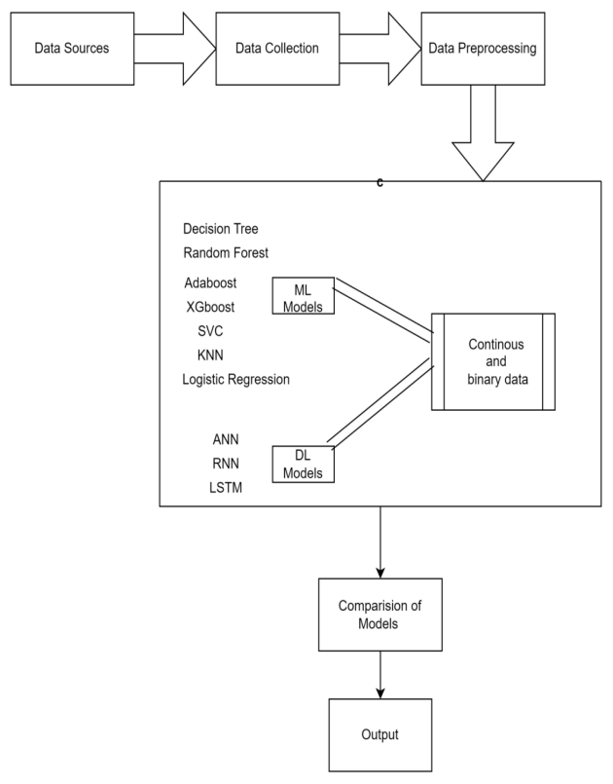
System Architecture

Slide 12
System Modules
To implement this project we have designed following modules
1.Upload Stock Dataset
2.Preprocess Dataset
3.Run Continuous Prediction
4.Run Binary Prediction
5.Comparison Graph
6.View Comparison Table

Slide 13
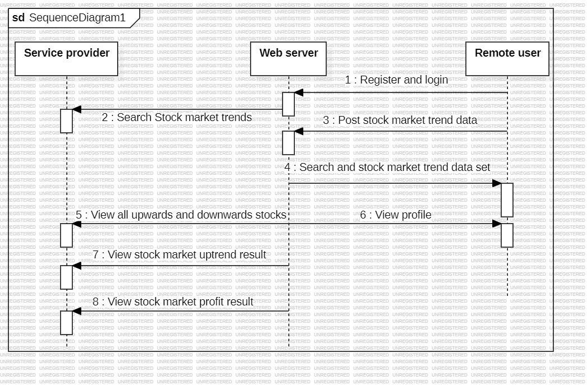
UML Diagrams
SEQUENCE DIAGRAM:

Slide 14
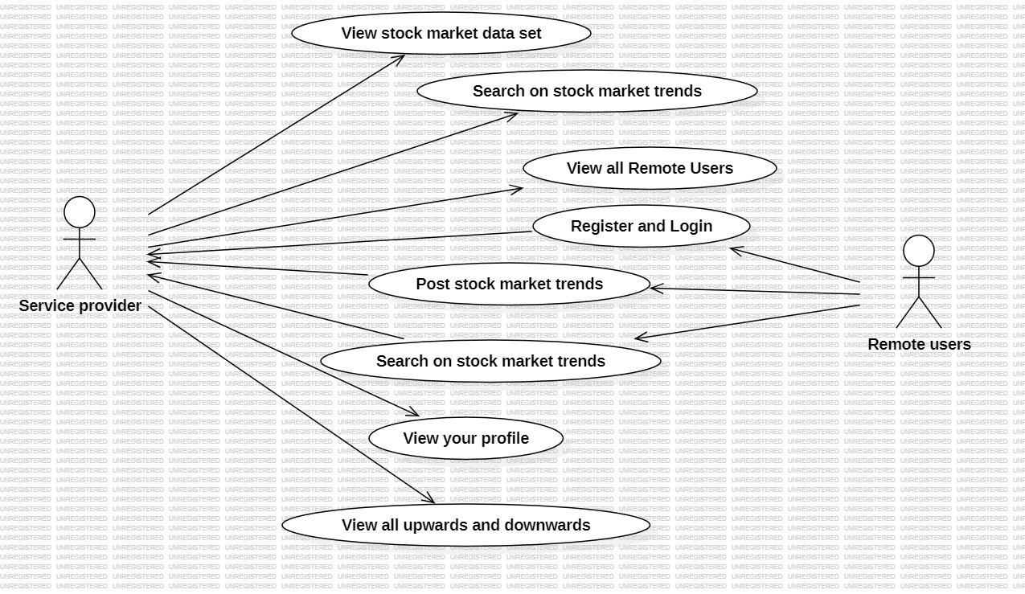
UML Diagrams
USE CASE DIAGRAM:

Slide 15
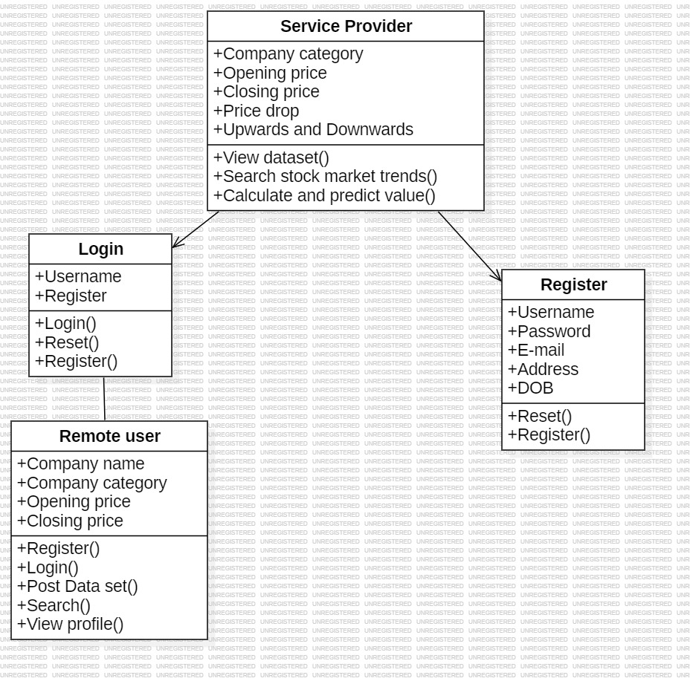
CLASS DIAGRAM:​

Slide 16
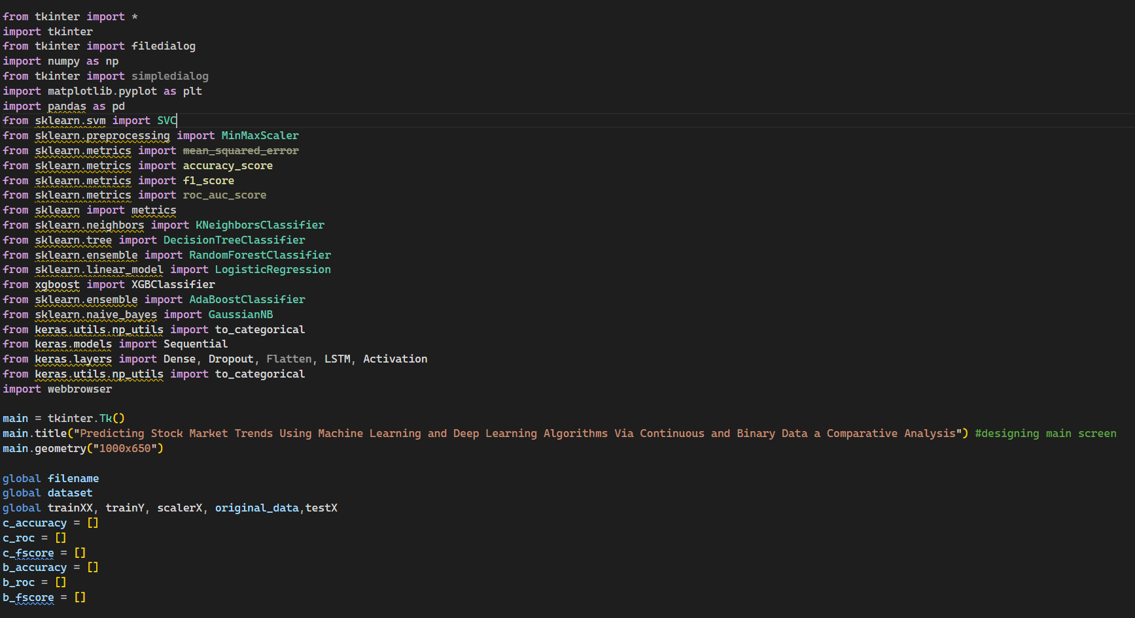
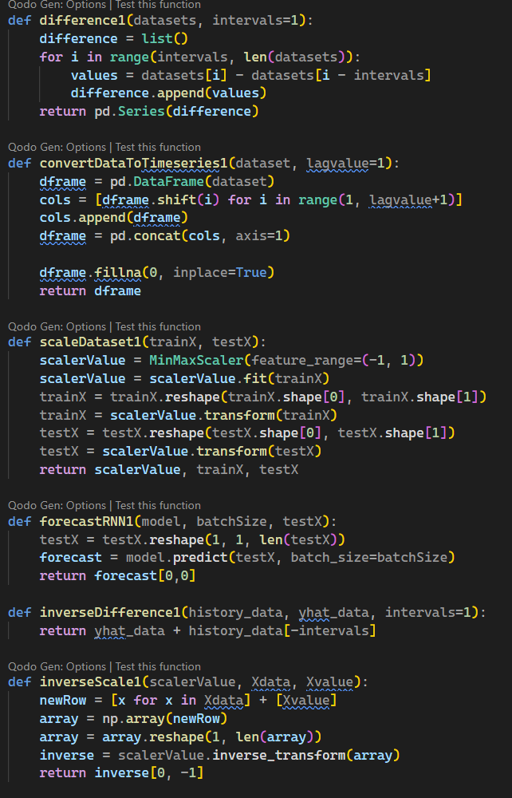
IMPLEMENTATION

Slide 17
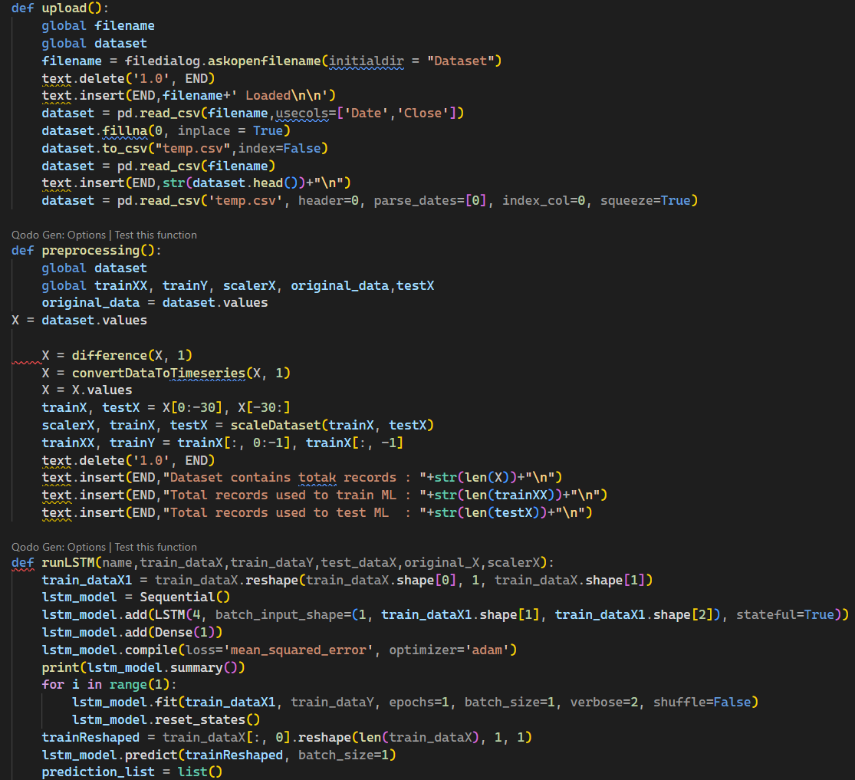
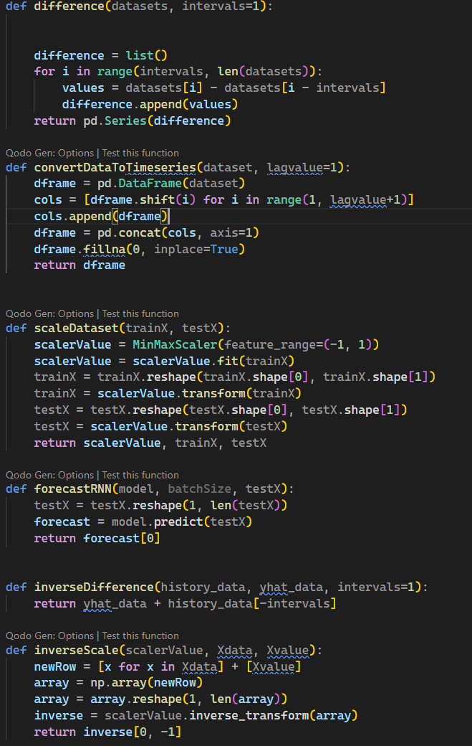
IMPLEMENTATION

Slide 18
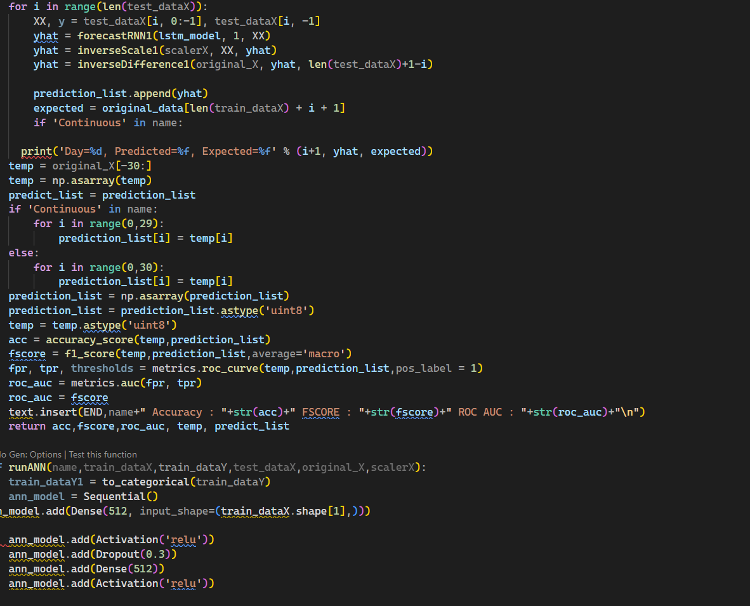
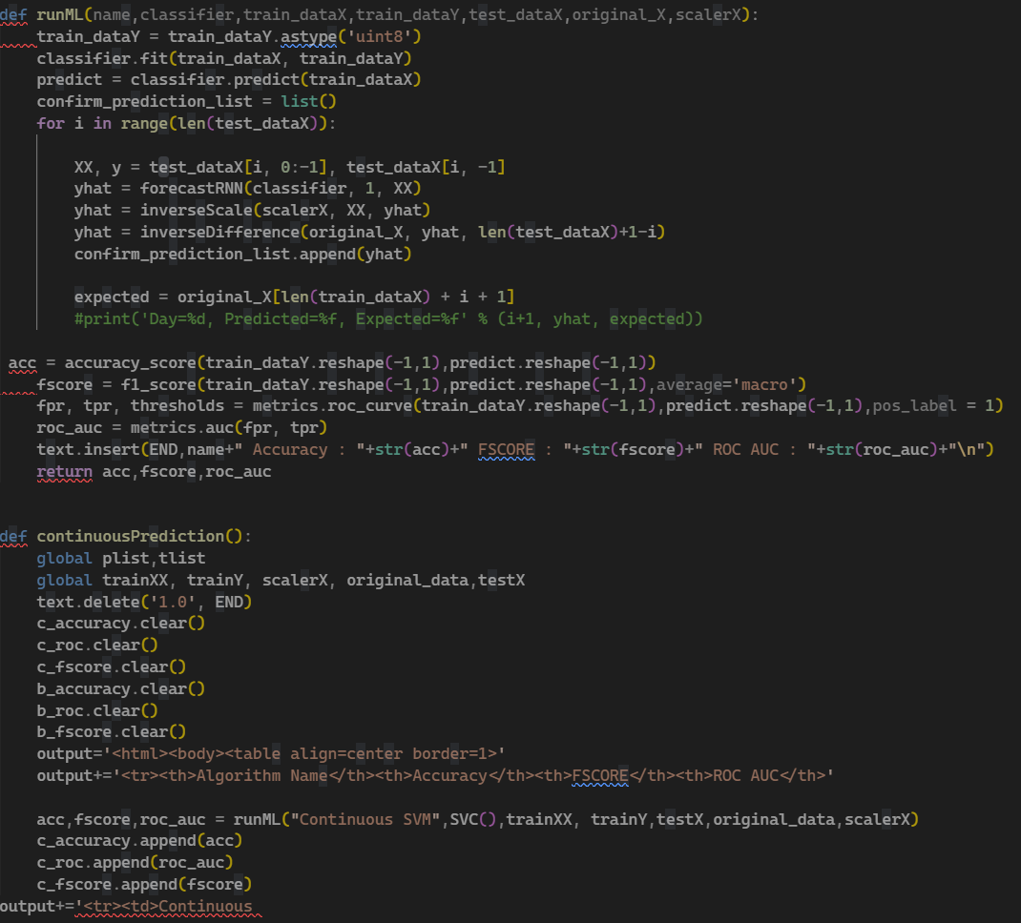

Slide 19
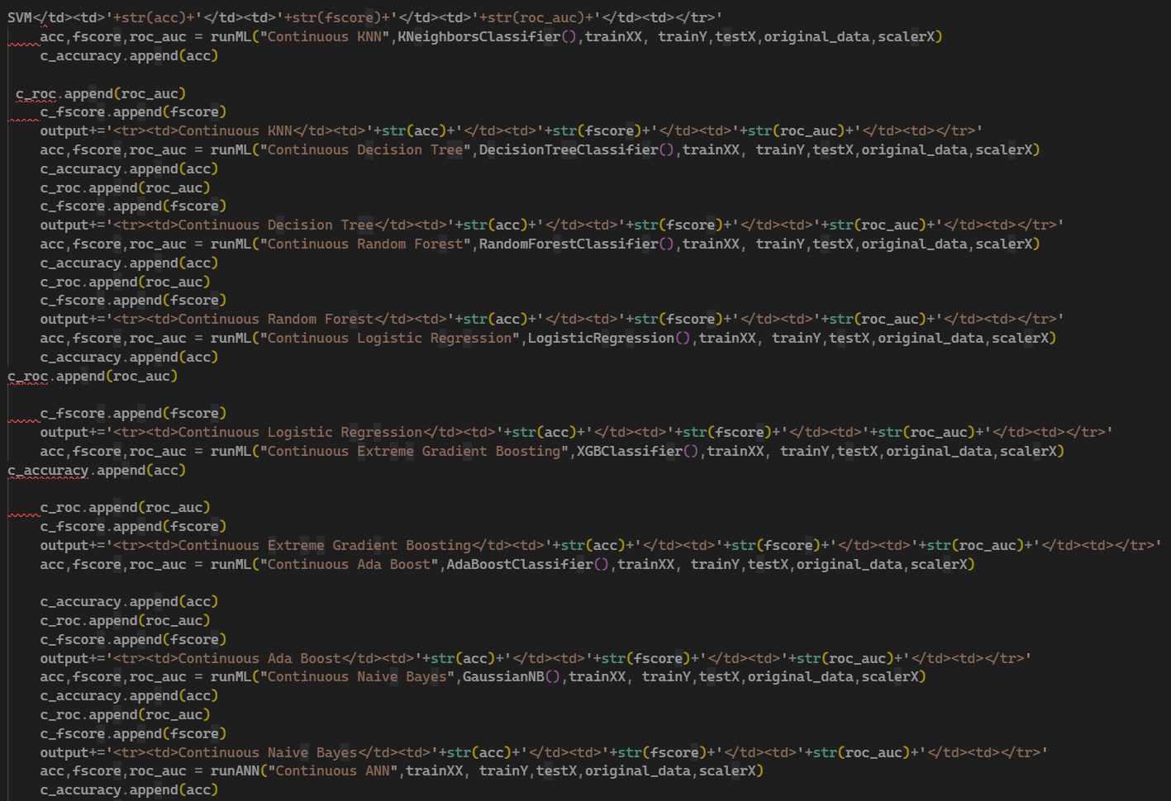
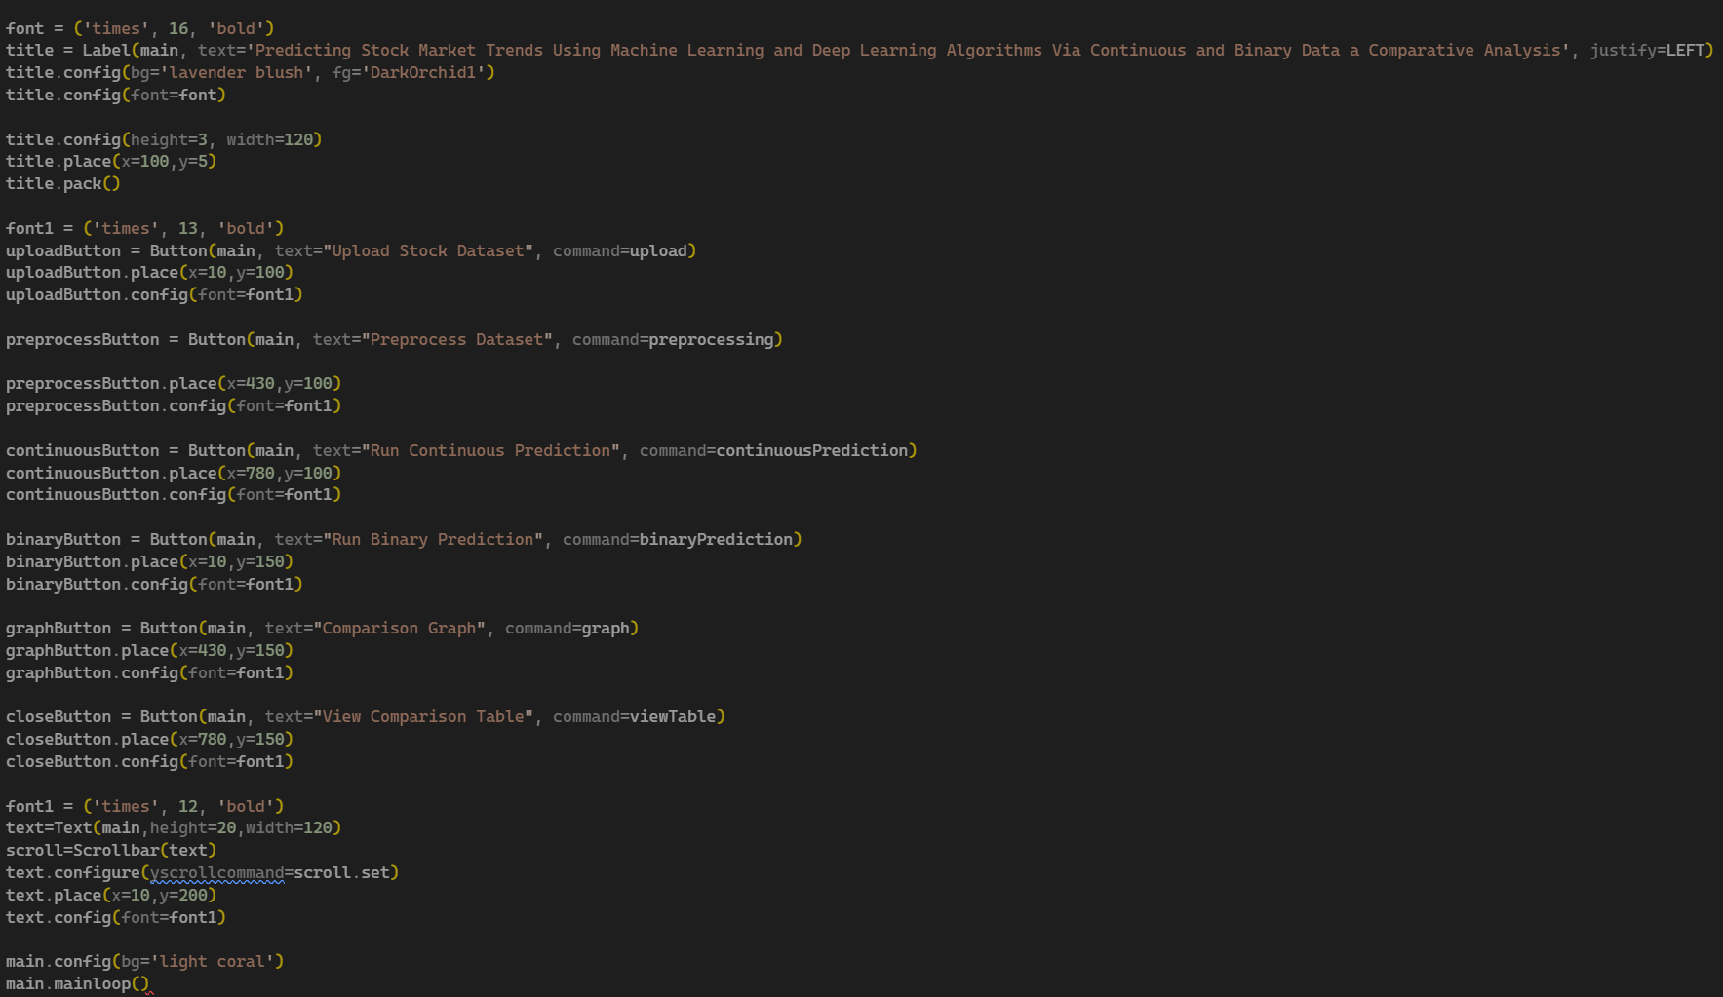

Slide 20
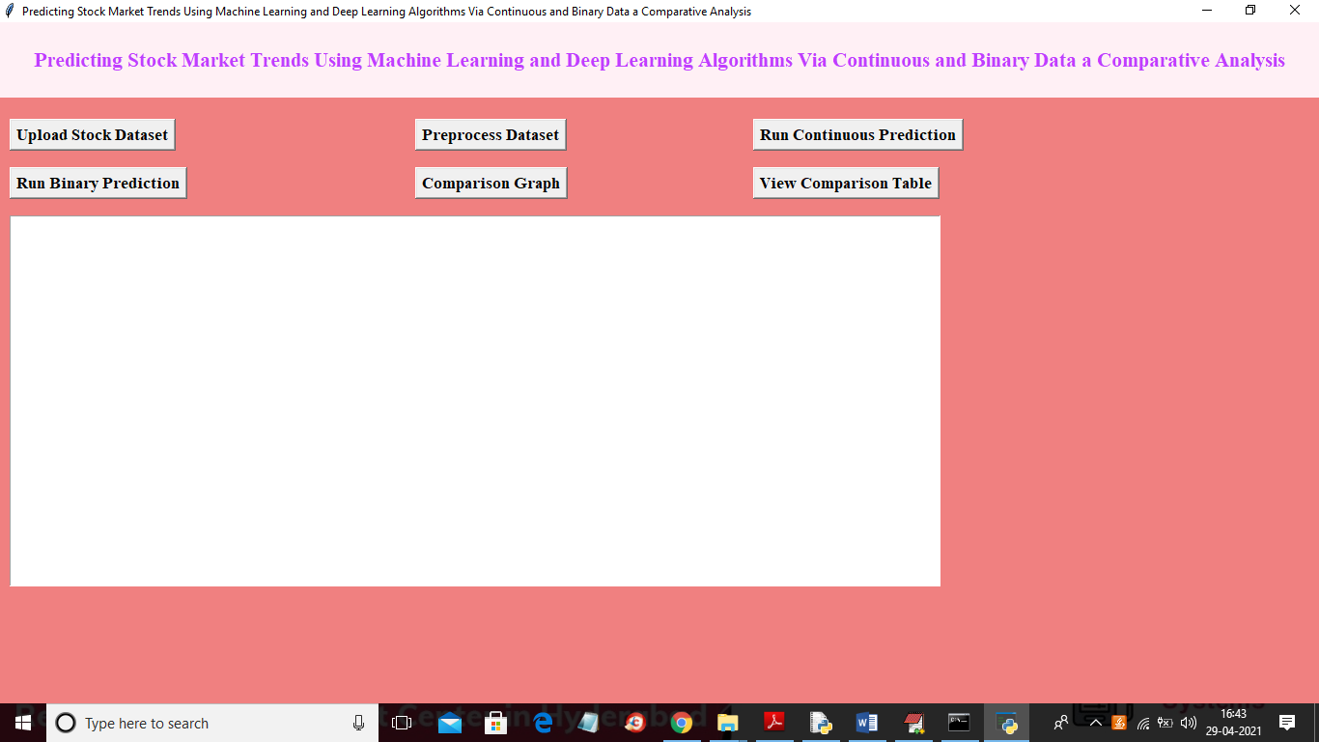
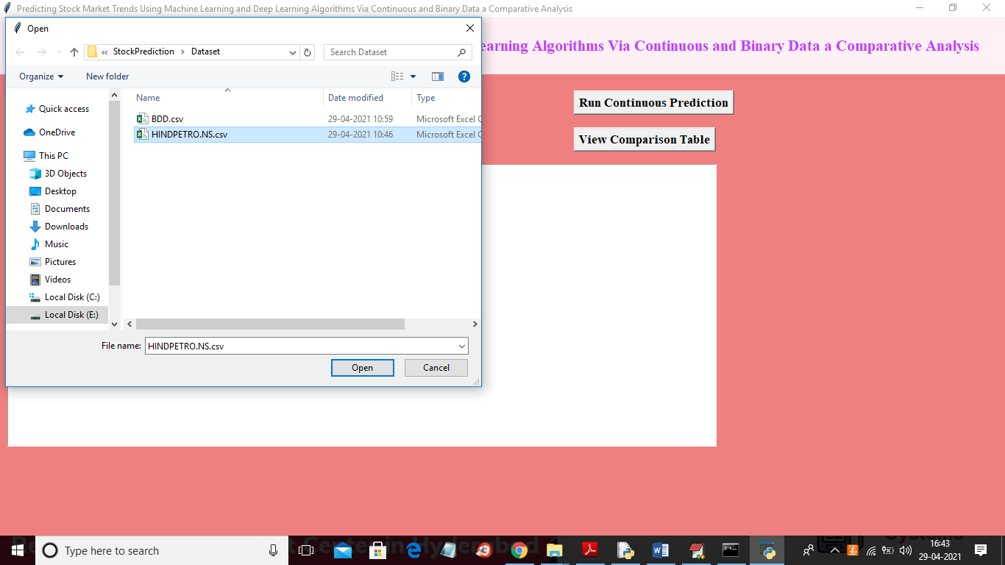
EXECUTION

Slide 21
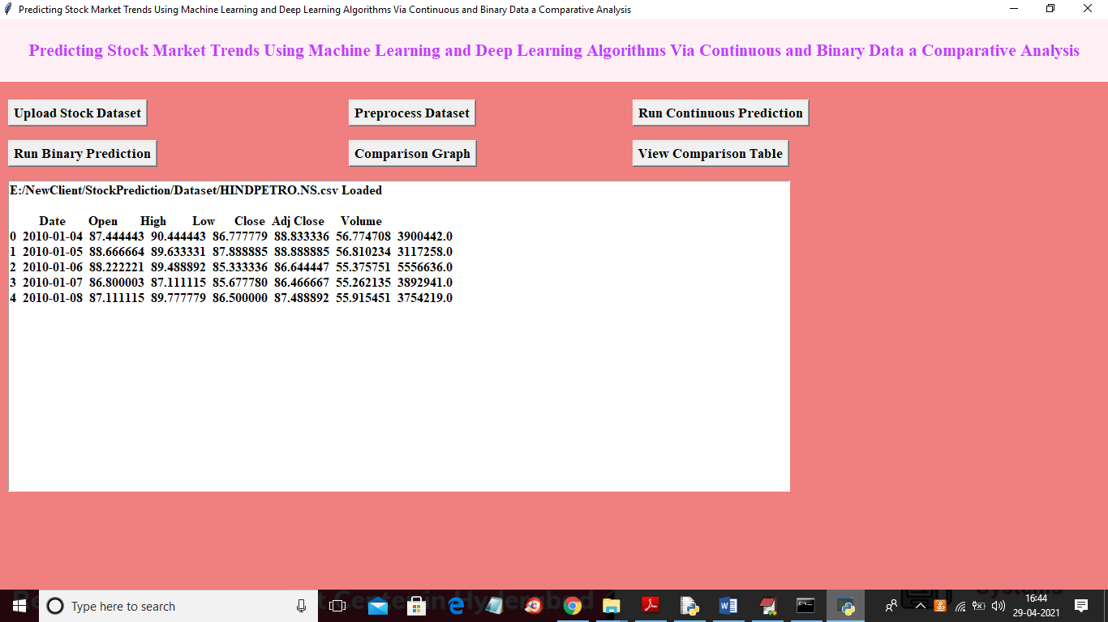
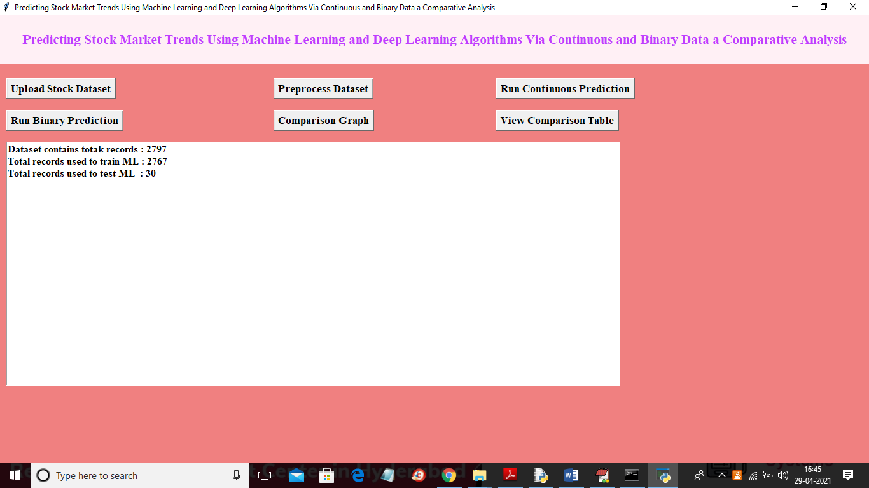
EXECUTION

Slide 22
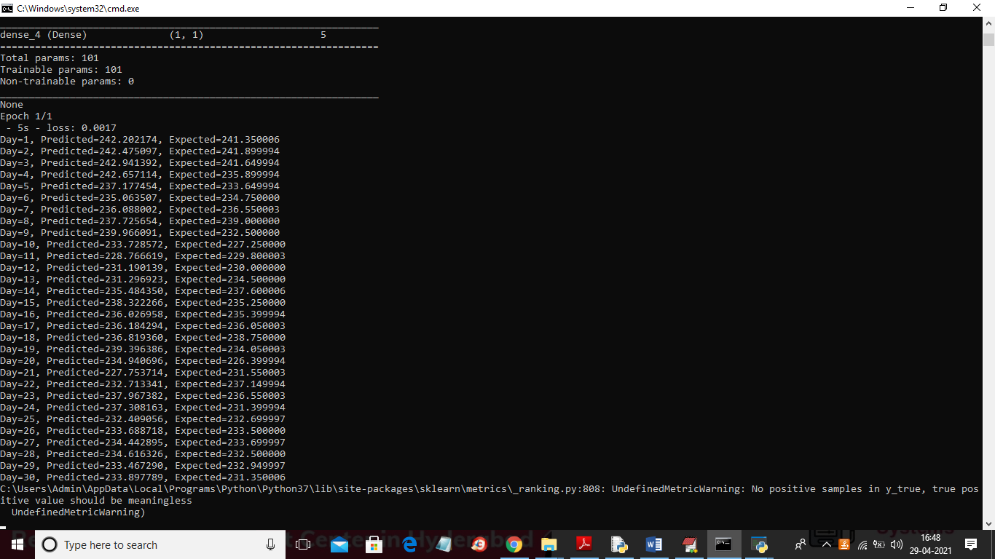
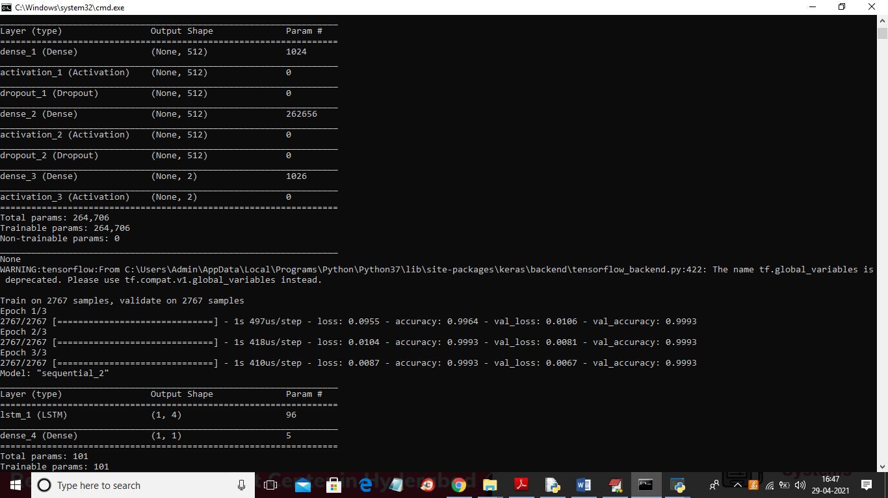
EXECUTION

Slide 23
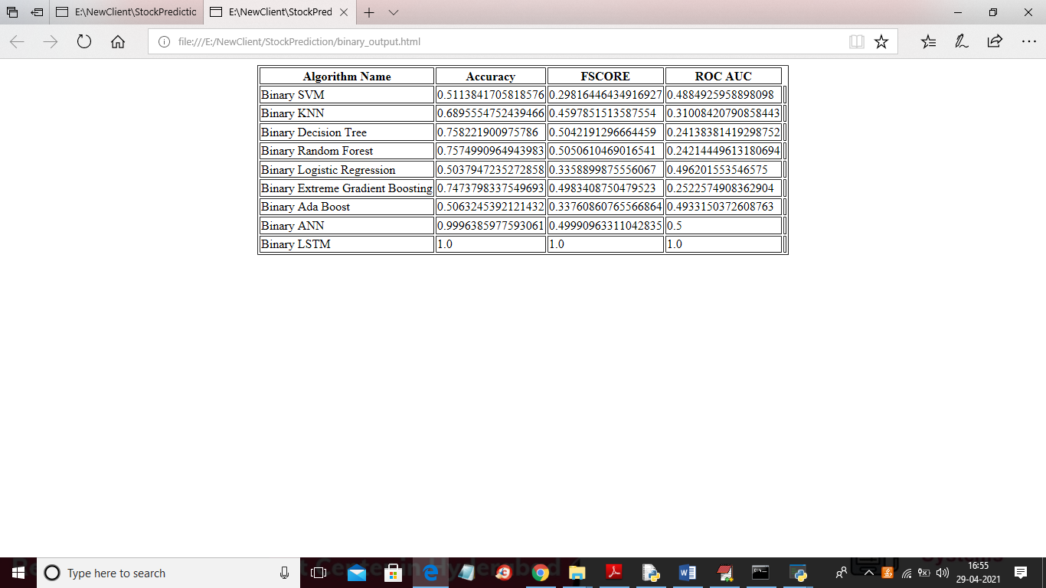
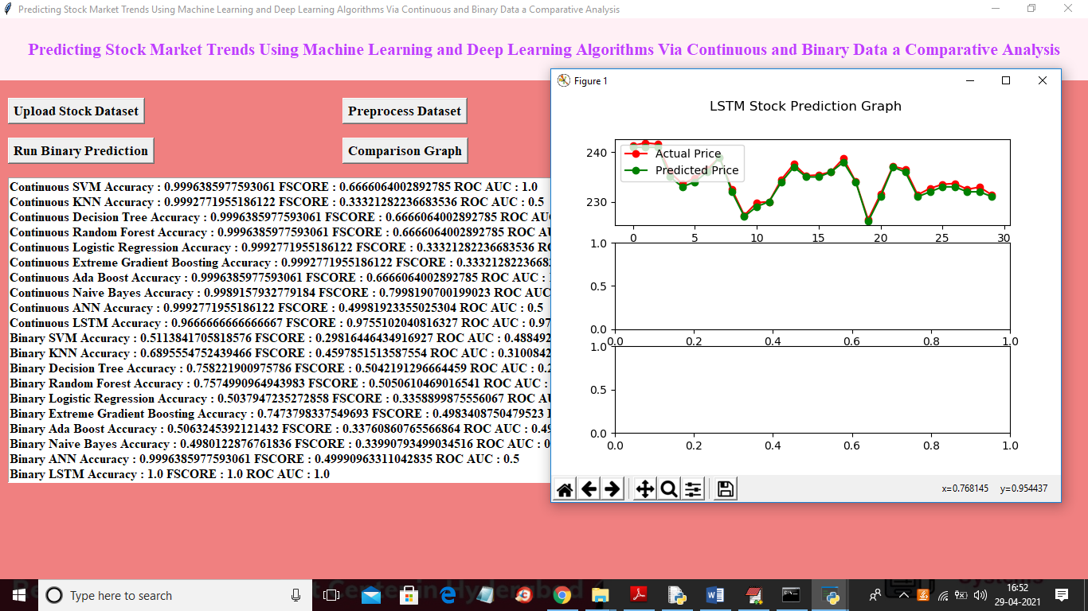
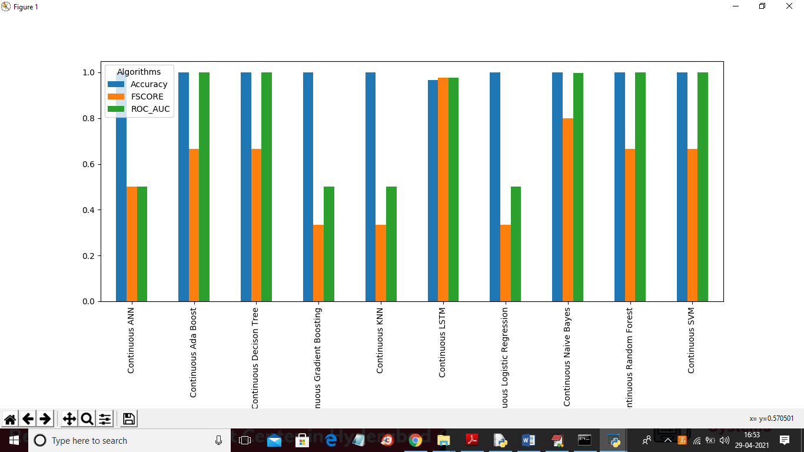
EXECUTION

Slide 24
FUTURE SCOPE
1. Expansion of Data Sources:
Real-time Data Processing: Implementing models that work with real-time streaming data can improve the model's predictive power and make it more applicable for real-time stock market analysis.
2. Hybrid Model Approaches:
Combine Multiple Algorithms: Developing hybrid models that combine both machine learning (e.g., Random Forests, SVMs) and deep learning techniques (e.g., LSTMs, CNNs) might improve accuracy. Ensemble models can also be explored for better generalization on different types of data.

Slide 25
References
"Machine Learning Techniques for Stock Market Prediction: A Review and Future Directions" (2022). IEEE International Conference on Big Data.
"A Comparative Analysis of Machine Learning Techniques for Stock Market Forecasting" (2023). ACM Conference on Data Science.
"Stock Price Prediction Using LSTM Recurrent Neural Network" (2023).
International Journal of Financial Studies.
[4] Baek, Yujin, and Ha Young Kim. "ModAugNet: A new forecasting framework for stock
market index value with an overfitting prevention LSTM module and a prediction LSTM
module." Expert Systems with Applications 113 (2018): 457-480.

Slide 26
Any Queries?

Slide 27
THANK YOU

